Slide 1

Objectives
In this session, you will learn to:
  Create State Machine diagrams
  Create Activity diagrams
Notes:
Initiate the session by explaining the session objectives to the students.

Slide 2
Creating State Machine Diagrams
A state machine diagram represents various states an object attains during its lifecycle in response to events.
The various constituents of a state diagram are:
  State machines
  Events
  Transitions
Notes:
Explain what state diagrams are. Also explain the components of a state diagram.

Slide 3
Understanding State Machine, Events, and Transitions
State machine depicts the various states of an object that change in response to events during its lifetime.
A state refers to the condition of an object during its existence in memory.
Every object has an initial and a final state.
Event is an occurrence that triggers change of state of an object.
The various types of events that act as triggers for objects are:
  Call event
  Signal event
  Time event
Notes:
Explain the concept of state machines, state, initial state, and final state by using the example of Inventory Management System given in the student guide. Explain the concept of an event and the various types of events.

Slide 4
Understanding State Machine, Events, and Transitions (Contd.)
Transition is a change of state of an object due to the occurrence of an event.
Advanced features of state machine include:
  Entry and exit actions
  Activities
  Internal transitions
  Substates
  Deferred events
Notes:
Explain the concept of a transition and the various parts of a transition (source state, event trigger, guard condition, action, and target state). Also explain the advanced features of a state machine by using the examples given in the student guide.
When you discuss guard conditions, you need to emphasize the factors that affect the specification of guard conditions. A transition that leaves a branch represents the if- condition. A guard condition shown on a transition represents the definition of the if-condition. The guidelines that you should keep in mind when you design the guard conditions are:
* Each transition that leaves a branch element must have a guard condition. It ensures that you have mentioned all the if-conditions that you have thought through all the possibilities for that decision point.
* Guard conditions on the transitions that leave the same branch should not overlap. For example, guard conditions, such as x < 0, x = 0, and x > 0, do not overlap as opposed to guard conditions, such as x <= 0 and x >= 0, which overlap. The system will not be able to decide the control flow path when x=0 becomes true.
* Guard conditions on the transitions that leave the same branch must form a complete set. For example, if there are only two transitions with the guard conditions, x < 0 and x >0, the system will be unable to respond when x=0 becomes true.
* An activity invariant is a condition that is always true when your system processes an activity. A guard condition should not overlap with the invariant conditions and the exit conditions of the activity. Otherwise, it could effect the actions of the activity.

Slide 5
Understanding State Machine, Events, and Transitions (Contd.)
A state that contains substates is called a composite state.
The two types of states that can exist in a composite state are:
  Sequential substates
  Concurrent substates
Notes:
Explain the concept of a composite state. Explain sequential substates and concurrent substates in a composite state.

Slide 6
Just a minute
Which of the following components signifies an occurrence that may cause a transition in the state of an object?
  Action
  Event trigger
  Source state
  Target state
Answer:
  Event trigger

Slide 7
Guidelines for Creating State Machine Diagrams
Guidelines for creating state machine diagrams are:
  Identify the collaboration for a system, class, or use case.
  Identify the start and end states for each object. You also need to identify the preconditions and post conditions of the start and end for each object.
  Identify the stable states of each object by taking into consideration all the preconditions and post conditions.
  Identify the events that cause a transition in the state of an object.
  Associate actions to each transition and state.
  Use the sequential and concurrent states to simply the state diagrams.
Notes:
Explain that the creation of state machine diagrams involves modeling the reactive objects of the software system. Reactive objects are the objects that respond to events by exhibiting a change in the state. The various elements that are essential to model reactive objects are states (simple and composite), transitions, events, actions.
Explain the guidelines for creating state machine diagrams.

Slide 8
Guidelines for Creating State Machine Diagrams (Contd.)
  Apply check on states that they are attainable.
  Ensure that an object does not attain a state from which there are no possible transitions to other states.
  Check the state diagram for the expected sequences of events with their responses.

Slide 9
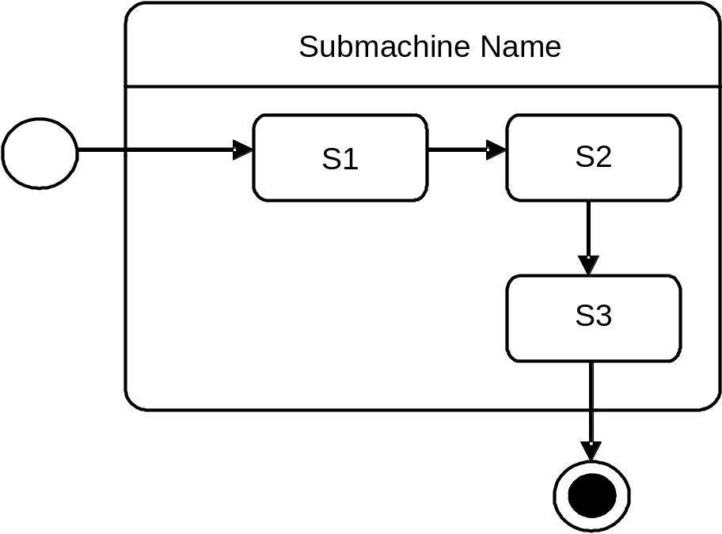
Submachines
A submachine is a type of state machine that contains multiple states.
The following figure depicts a submachine containing three states.
Notes:
Explain the concept of submachines and submachine reference states by using the example given on the slide.

Slide 10
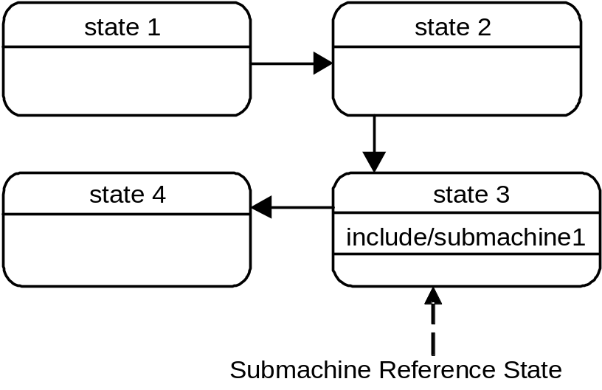
Submachines (Contd.)
You represent a submachine as a state in a state machine diagram, as shown in the following figure.
You can use a submachine in multiple state machines. This avoids repetition of the states of the submachines in other state machines.
Notes:
Explain that a submachine can be represented as a state machine. Explain the benefit of using submachines. Explain the concept of stub states inside the submachine reference state by using the example of the Ticket Selling System given in the student guide.

Slide 11
Stubbed and Complex Transitions
Stubbed transitions:
  Cause a change of state of an object from simple state to a state of a submachine.
  Is depicted from the following:
    A stub state to a simple state.
    A simple state to a stub state.
Notes:
Explain the concept of stubbed transitions by using the example given in the student guide.

Slide 12
Stubbed and Complex Transitions (Contd.)
Complex transitions have more than one source or target state.
If the source of the transition is concurrent substates, then a join is used to depict the transition.
If the target state is a concurrent state, then a fork is used to depict the transition.
If the source and target states are concurrent states, then their joining represents a synchronization of the parallel threads of control.
Notes:
Explain the use of join and fork in represented complex transitions.

Slide 13
Creating Activity Diagrams
To design a process, you need to define the actions that constitute the process and the order in which they execute.
The sequence of steps represents a workflow and enables you to design your system efficiently.
You use an activity diagram to model the flow of control of a particular process.
Notes:
Explain the need for creating activity diagram by using the example of the Automated Product Sales System (APSS) given in the student guide.

Slide 14
Creating Activity Diagrams (Contd.)
An activity diagram is a special type of state machine diagram.
Activity diagram uses all the elements of a state diagram along with some additional elements, such as activity states.
The control flow begins from the start state or the initial state and ends in another state known as the end state.
The basic elements of an activity diagram are:
  Action state
  Activity state
  Transition
  Decision
Notes:
Explain activity diagram as a special type of state machine diagram. Explain the basic elements of an activity diagram.

Slide 15
Identifying Flows, Partitions, and Pins
An activity diagram also consists of other optional elements, such as flows, partitions, and pins.
Flows:
  Represent the relationship between two actions.
  Flows can be classified as:
    Control flow
    Object flow
Partitions:
  Create logical groups of activity states such that each group represents the responsibility of a particular class.
  Is depicted using swim lanes that categorize the activities and depict their flow.
Notes:
Explain the optional elements of an activity diagram (Flows, partitions, and pins). Explain the two types of flows and the types of elements used to model the flow.

Slide 16
Identifying Flows, Partitions, and Pins (Contd.)
Signals:
  Are events that occur outside the process but still have an impact on the process.
  Are depicted using the keyword, <<signal>>.
  Can be related to other signals through a generalization relationship.
Notes:
Explain the concept and benefit of using a partition by using the example given in the student guide. Explain the concept of signals and the generalization relationship among signals by using the example given in the student guide. Explain the symbol for sending a symbol and the symbol for receiving a signal. Use the example of Online Transaction System given in the student guide to explain the concept of signals.

Slide 17
Identifying Flows, Partitions, and Pins (Contd.)
Pins and Transformations:
  Pins represent the input and output parameters of activity states in an activity diagram.
  Transformations convert the type of output parameters of the outbound action to the required parameter type of the inbound action.
  Transformations are shown on each of the outgoing transactions.
  Transformations are modeled within a pair of angle brackets as <<transformation>> followed by the name of the transformation.
Notes:
Explain the concept of pins and transformations by using the example of the online transaction system given in the student guide.

Slide 18
Depicting Expansion Regions, Flow Final, and Join Specifications
Activity diagrams provide the following elements to model control flow mechanisms:
  Expansion region
  Flow final
  Fork and Join
Expansion Region:
  Can be implemented in the following three modes:
    Concurrent
    Iterative
    Stream
  You depict the expansion region as a dotted rectangle.
Notes:
Introduce the terms expansion regions, flow final, fork, and join in the context of an activity diagram.

Slide 19
Depicting Expansion Regions, Flow Final, and Join Specifications (Contd.)
Flow final:
  Indicates the end of a particular flow, not the end of an activity.
Fork and join:
  A fork is shown as a bar with one incoming transition and multiple outgoing transitions.
  A join is also shown as a bar with one outgoing transition and multiple incoming transitions.
Notes:
Explain the three modes in which an expansion region can be implemented. Explain the notation for an expansion region. Explain the use of expansion regions by using the example of the online transaction system given in the student guide. Explain the use of flow final by using the example given in the student guide. Explain the use of fork and join by using the example given in the student guide.

Slide 20
Steps to Create Activity Diagrams
To create an activity diagram:
  Identify the scope of the activity diagram.
  Add the start and end states.
  Add action states and object states.
  Add transitions among the actions or sub activities.
  Add a transition from the start state to the first action state to show the direction of flow of control.
  Add all the transitions of other action states.
  Add a transition from the last action state to the end state to show the end of flow and activity.
  Add decision points.
Notes:
Explain the steps to create an activity diagram.

Slide 21
Steps to Create Activity Diagrams (Contd.)
  Add the branch and merge constructs to group and merge the transitions to show the change of direction of flow.
  Identify the end of flows. Identify the flows which could end before the activity ends. Model these flows as flow finals.
  Identify concurrent actions and model them using forks and joints.

Slide 22
Just a minute
Which of the following elements of activity diagram represents the control flow that performs particular operation?
  Action state
  Activity state
  Transition
  Decision
Answer:
  Transition

Slide 23
Demo: Creating an Activity Diagram for the InfoSuper Bank ATM
Problem Statement:
  Create the activity diagram showing the process of withdrawing the money from an ATM machine.
Notes:
Explain the problem statement to the students.

Slide 24
Demo: Creating an Activity Diagram for the InfoSuper Bank ATM (Contd.)
Solution:
  To create the activity diagram, you need to perform the following tasks:
    Identify the process to be modeled.
    Identify the Activity States, Signals.
    Identify the Branch Elements.
    Identify the Parallel Flows.
    Create an activity diagram.
Notes:
Before starting the demo, you need to copy the required data file from the <<<<<<<PATH>>>>>>>>>> folder. The required data file’s name is Bank_ATM.vsd.
Demonstrate the solution to the problem statement by following the steps given in the student guide. If you want to show students the final diagram that will be created after performing the demo, you can open the Bank_ATM.vsd file from the <<<<<<<PATH>>>>>>>>> folder.
The demo does not repeat similar steps. However, you would be able to complete the diagram with the steps written in the demo.

Slide 25
Summary
In this session, you learned that:
  State diagrams depict the various states of an object that change due to the occurrence of events. The various elements of state diagrams are simple and composite states, transitions, events, and actions.
  The need of activity diagrams to model the control flow and to identify the dependability among use cases.
  The way to use actions and activity states in an activity diagram to model workflows and operations.
  The use of the basic elements of activity diagrams, such as transitions, to model the control flow. Branch and merge elements are used to model decisions such as if-conditions.
  The use of the swim lane element to group activities. Swim lanes enable you to group the activity states according to their responsibilities.
Notes:
Summarize the session by using the summary points given on the slide.

Slide 26
Summary (Contd.)
  The use of pins and transformations to transform the parameters of outbound actions to inbound actions. Transformations enable you to convert the parameters of the outbound parameters to inbound parameters.
  The expansion region element is used to model loops to process input elements in three modes, concurrent, sequential and stream. Expansion region can also act as a filter in which it filters the input collection to produce an output collection
  The flow final element is used to model the end of flow, such as exceptions that occur in an activity.
  The use of the fork and join elements to model parallel flows and maintain concurrency.
  The standard approach is applied to create activity diagrams for a new process. The procedure includes the tasks to identify the process to be modeled, the actions and signals, and the identifying parallel flows.
Notes:
Summarize the session by using the summary points given on the slide.

